Slide 1
VITAMINS
Mrs.shali B.S. Msc Nursing
Assistant professor
Child Health Nursing
Annammal college of Nursing ,Kuzhithurai

Slide 2
Vitamins are micronutrients which play a crucial role in maintaintaining various biological processes in human body
These are classified broadly into two groups
Vitamin A is an important member of Fat soluble vitamins Group which plays a vital role in maintaining good vision and aids cellular growth
Discovered in the year 1913, it was initially termed as the ‘ANTI INFECTIVE VITAMIN

Slide 3
MECHANISM OF ABSORPTION IN THE BODY
SINCE vitamin A is fat soluble in nature .It cannot be directly absorbed from the diet and hence it is first solubilized to micelles in the intestinal lumen and further absorbed by the duodenal mucosal cells

Slide 4
PREVALENCE
Vitamin A deficiency is the leading cause of preventable blindness in children.
It also increases risk of pregnancy various diseases and in some cases death from severe infections.
In recent study has stated that world wide approximately 4.4 million preschool kids develop visible vision damage due to vitamin A deficiency

Slide 5
SOURCES
Vegetables like sweet potato,spinach,carrots,tomato,etc.
Animal sources include
Hard boiled egg
Chicken breast
Salmon
Tuna
Yogurt,pista,mango,dried apricots
Fortified ready to eat cereals

Slide 7
FUNCTIONS
Promote growth of strong teeth and bones.
Normal brain development and functioning of the nervous system
Maintenance of a healthy skin texture and prevents dry skin
It is essential for maintaining a good eye sight
Carotene acts as an anti oxidant and protect cell damage by free radicles

Slide 8
DEFICIENCY DISORDERS
XEROPHTHALMIA
This condition encompasses all the defects which affect the eyes
1. NIGHT BLINDNESS
It indicates complete lack of vision at night
Human retina has specialized photo receptor cells rods,cones.
It can be both hereditary and acquired

Slide 10
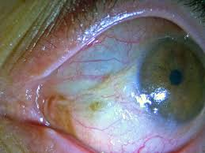
2.Conjunctival xerosis
Extreme dryness of the eye surfaces caused by deficiency of tears or conjunctival secretions
It is mainly caused due to loss of goblet cells of the conjunctival epithellium

Slide 11
3.Bitot’s spot
It is characterized by presence of a thickened superficial layer of flattened cells having a frayed keratinised surface with prominent gram positive bacteria or in some cases even fungi

Slide 12
4.Corneal xerosis
This is a mpre advanced stage of lesions which represent severe vitamin A Deficiency
It is highly reversible and can treated using external vitamin A supplements.

Slide 13
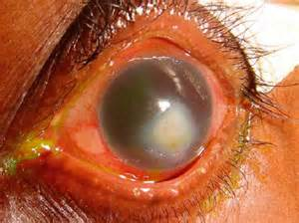
5.keratomalacia
This is last stage of xerothalmia where there is complete destruction of cornea
IT usually affects both eyes
Severity can vary from mild to severe
In extreme cases it can also cause blindness Affects younger age

Slide 14
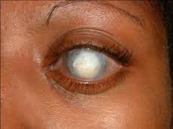
6. Corneal scars
It occur due to injury ,infection, or xerophthalmia
It affects both sides of cornea
These can be two forms ACTIVE AND INACTIVE
COMMON IN YOUNGER CHILDREN
OTHER CONDITIONS
cancer.,measles,and age related macular degeneration

Slide 15
TREATMENT OF DISORDERS
Treatment involves diet pattern modification include foods rich in the deficient nutrient.
Coloured vegetables
Supplements

Slide 16
VITAMIN A TOXICITY
Hypervitaminosis can be majorly caused either due to excessive dietary intake
Accumulat e in the liver and excreated in the body.
Symptoms like nausea,headache,dizziness,skin irritation.jointpain,coma,and death

Slide 17
RDA of Vitamin A
AGE | MALE | FEMALE | PREGNANCY | LACTATION
0-6 MONTHS | 400 mcg | 400 mcg
7-12 months | 500 mcg | 500 mcg
1-3 years | 300 mcg | 300 mcg
4-8 years | 400 mcg | 400 mcg
9-13 years | 600 mcg | 600 mcg
14-18 years | 700 mcg | 700 mcg | 750 mcg | 1200 mcg
19-50 years | 700 mcg | 700 mcg | 770 mcg | 1300 mcg
51- | 700 mcg | 700 mcg

Slide 18
VITAMIN - C
It is an essential nutrient that plays an important role in many biological processes
It was discovered by an Hungarian biochemist ALBERT in 1928

Slide 19
FUNCTIONS
COLLAGEN SYNTHESIS
Anti oxidant
Common cold
Allergy and Asthma relief
Immunity
AMD
Iron absorption
Cardiac diseases
Amino acid synthesis

Slide 20
DEFICIENCY OF VIT C
SCURVY
SYMPTOMS
Weakness ,malaise, fatique,and gum inflammation
Poor wound healing, depression,swollen and bleeding gums .teeth loss
Prolong vit c –bone diseses in children. nervous system related problem ,edema and shortness of breath

Slide 21
RISK…..
Smokers or passive smokers
Individuals consuming limited food variety
Infant who feed on evaporated or boiled milk
Individuals with certain medical conditions

Slide 22
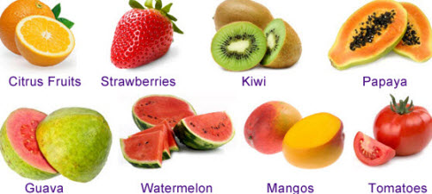
SOURCES
Fruits
Vegetables
Animal sources

Slide 24
VIT C TOXICITY
Ingestion of high doses of vit c might cause diarrhea,and gastro intestinaldisturbances,nausea,vomiting,insomnia,fatique/headache,hot flashes and skin rashes
Erosion of dental enamel
Normal levels 0.6-2.0 mg/dl
The tolerable upper intake of vit c 2000 mg/dl

Slide 25
RDA VIT C
1-8 YEARS -15-25mg /dl
9-18 years -45-75 mg/dl
Adult male -90 mg/dl
Adult female -75 mg/dl

